Slide 1
Chapter 3: Processes

Slide 2
Process Concept
An operating system executes a variety of programs that run as a process.
Process – a program in execution; process execution must progress in sequential fashion. No parallel execution of instructions of a single process
Multiple parts
The program code, also called text section
Current activity including program counter, processor registers
Stack containing temporary data
Function parameters, return addresses, local variables
Data section containing global variables
Heap containing memory dynamically allocated during run time

Slide 3
Process Concept (Cont.)
Program is passive entity stored on disk (executable file); process is active
Program becomes process when an executable file is loaded into memory
Execution of program started via GUI mouse clicks, command line entry of its name, etc.
One program can be several processes
Consider multiple users executing the same program

Slide 4
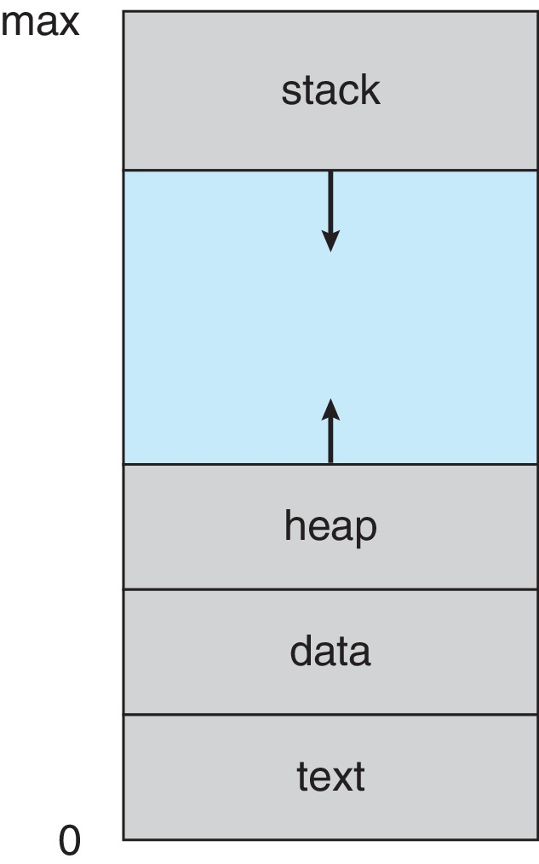
Process in Memory

Slide 5
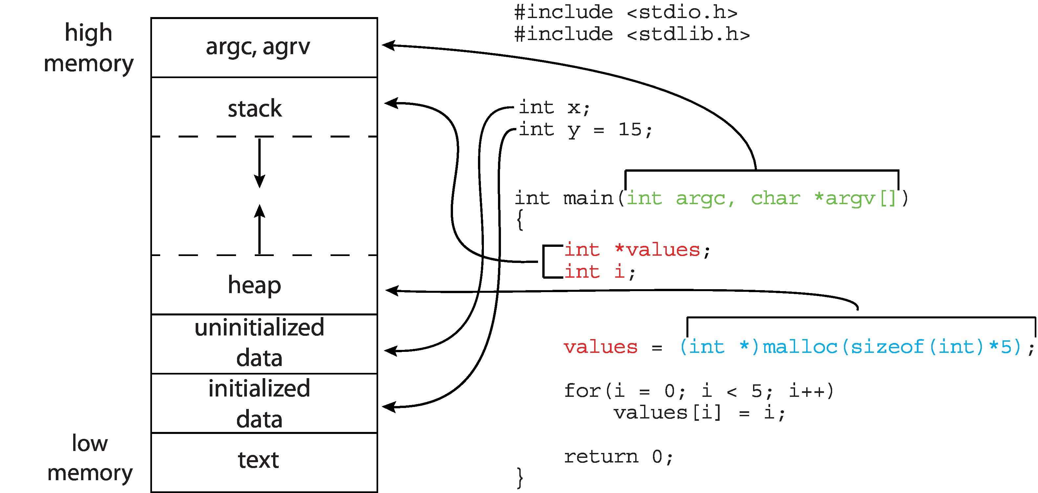
Memory Layout of a C Program

Slide 6
Process State
As a process executes, it changes state
New: The process is being created
Running: Instructions are being executed
Waiting: The process is waiting for some event to occur
Ready: The process is waiting to be assigned to a processor
Terminated: The process has finished execution

Slide 7

Diagram of Process State

Slide 8
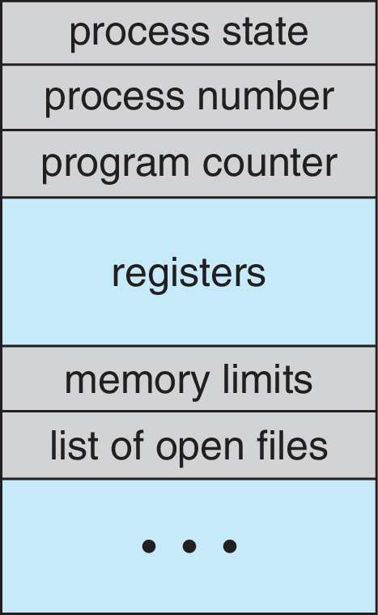
Process Control Block (PCB)
Information associated with each process(also called task control block)
Process state – running, waiting, etc.
Program counter – location of instruction to next execute
CPU registers – contents of all process-centric registers
CPU scheduling information- priorities, scheduling queue pointers
Memory-management information – memory allocated to the process
Accounting information – CPU used, clock time elapsed since start, time limits
I/O status information – I/O devices allocated to process, list of open files

Slide 9
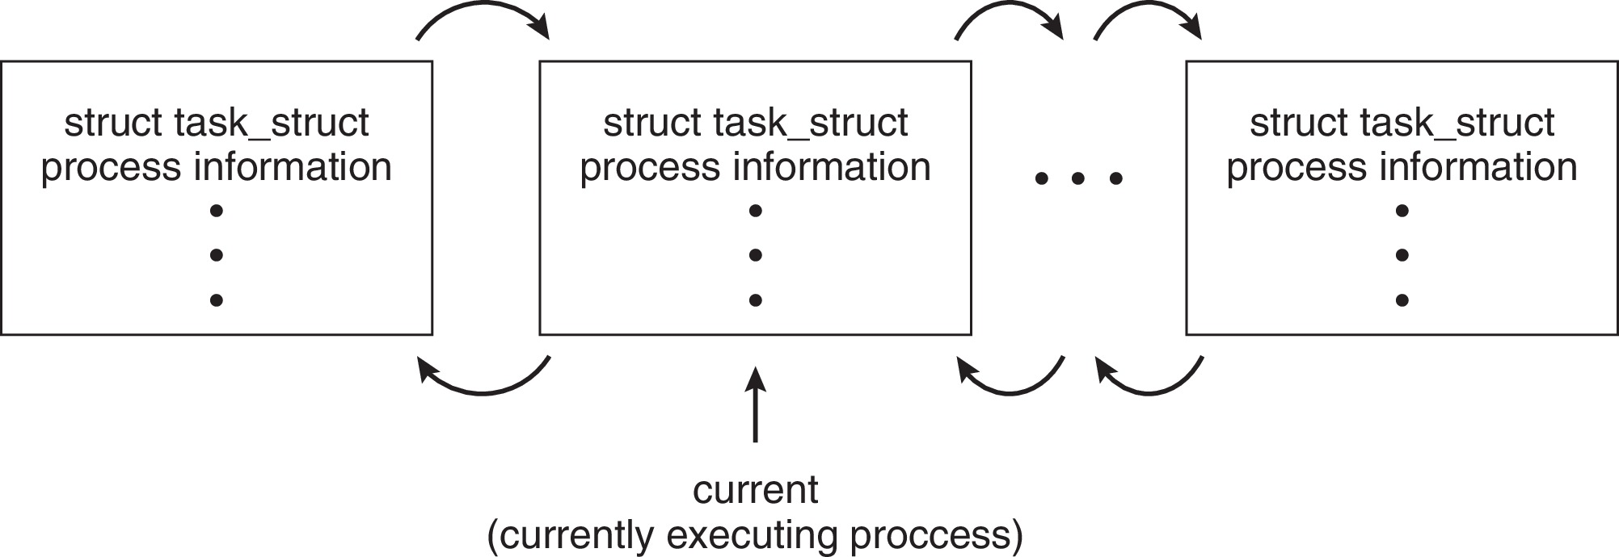
Process Representation in Linux
Represented by the C structure task_struct
pid t_pid; /* process identifier */ long state; /* state of the process */ unsigned int time_slice /* scheduling information */ struct task_struct *parent;/* this process’s parent */ struct list_head children; /* this process’s children */ struct files_struct *files;/* list of open files */ struct mm_struct *mm; /* address space of this process */

Slide 10
Interrupts

Slide 11
Computer-System Operation
An interrupt is a signal sent to the processor by hardware or software to indicate that an immediate action is required.
Interrupts are crucial for efficient multitasking and real-time responsiveness in an operating system (OS). They allow the CPU to temporarily stop executing its current instructions, handle an event (e.g., I/O completion, timer expiration, system call), and then resume execution.

Slide 12
Computer-System Operation
Types of Interrupts
Hardware Interrupts
Generated by external devices (e.g., keyboard, disk controller, network interface) to signal an event.
Example: When a key is pressed on a keyboard, an interrupt signals the CPU to process the keystroke.
Software Interrupts
Triggered by executing a special instruction in software. These are typically used for system calls.
Example: When a user program requests file access, it triggers a system call via a software interrupt.

Slide 13
Computer-System Operation
Types of Interrupts
Hardware Interrupts
Generated by external devices (e.g., keyboard, disk controller, network interface) to signal an event.
Example: When a key is pressed on a keyboard, an interrupt signals the CPU to process the keystroke.
Software Interrupts
Triggered by executing a special instruction in software. These are typically used for system calls.
Example: When a user program requests file access, it triggers a system call via a software interrupt.

Slide 14
Common Functions of Interrupts
Interrupt transfers control to the interrupt service routine generally, through the interrupt vector, which contains the addresses of all the service routines
Interrupt architecture must save the address of the interrupted instruction
Incoming interrupts are disabled while another interrupt is being processed to prevent a lost interrupt
A trap is a software-generated interrupt caused either by an error or a user request
An operating system is interrupt driven

Slide 15
Interrupt Handling
The operating system preserves the state of the CPU by storing registers and the program counter
Separate segments of code determine what action should be taken for each type of interrupt

Slide 16
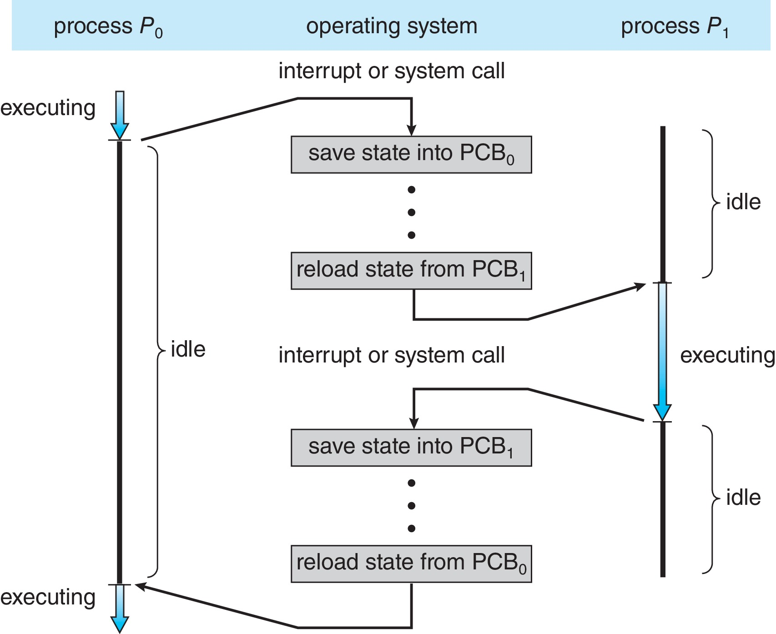
CPU Switch From Process to Process
A context switch occurs when the CPU switches from one process to another.

Slide 17
Context Switch
When CPU switches to another process, the system must save the state of the old process and load the saved state for the new process via a context switch
Context of a process represented in the PCB
Context-switch time is pure overhead; the system does no useful work while switching
The more complex the OS and the PCB ➔ the longer the context switch
Time dependent on hardware support
Some hardware provides multiple sets of registers per CPU ➔ multiple contexts loaded at once

Slide 18
Multitasking in Mobile Systems
Some mobile systems (e.g., early version of iOS) allow only one process to run, others suspended
Due to screen real estate, user interface limits iOS provides for a
Single foreground process- controlled via user interface
Multiple background processes– in memory, running, but not on the display, and with limits
Limits include single, short task, receiving notification of events, specific long-running tasks like audio playback
Android runs foreground and background, with fewer limits
Background process uses a service to perform tasks
Service can keep running even if background process is suspended
Service has no user interface, small memory use

Slide 19
Operating System Operation Modes

Slide 20
Operating-System Operation Modes
Manage interruptions
Interrupt driven by hardware
Software error or request creates exception or trap
Division by zero, request for operating system service
Detect other process problems include infinite loop, processes modifying each other or the operating system
In order to protect the execution of the processes and the OS itself, the OS can uses the Dual-Mode operation.

Slide 21
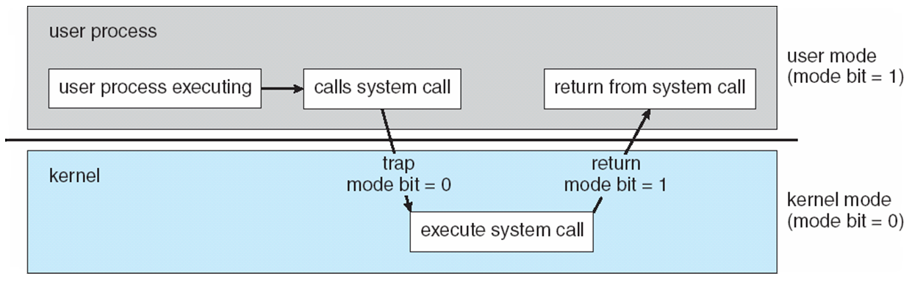
Operating-System Operation Modes
Dual-mode operation allows OS to protect itself and other system components
User mode and kernel mode
Mode bit provided by hardware
Provides ability to distinguish when system is running user code or kernel code
Some instructions designated as privileged, only executable in kernel mode
System call changes mode to kernel, return from call resets it to user

Slide 22
System Calls

Slide 23
System Calls
Programming interface to the services provided by the OS
Typically written in a high-level language (C or C++)
Mostly accessed by programs via a high-level Application Program Interface (API) rather than direct system call use
Three most common APIs are Win32 API for Windows, POSIX API for POSIX-based systems (including virtually all versions of UNIX, Linux, and Mac OS X), and Java API for the Java virtual machine (JVM)
Why use APIs rather than system calls?
(Note that the system-call names used throughout this text are generic)

Slide 24
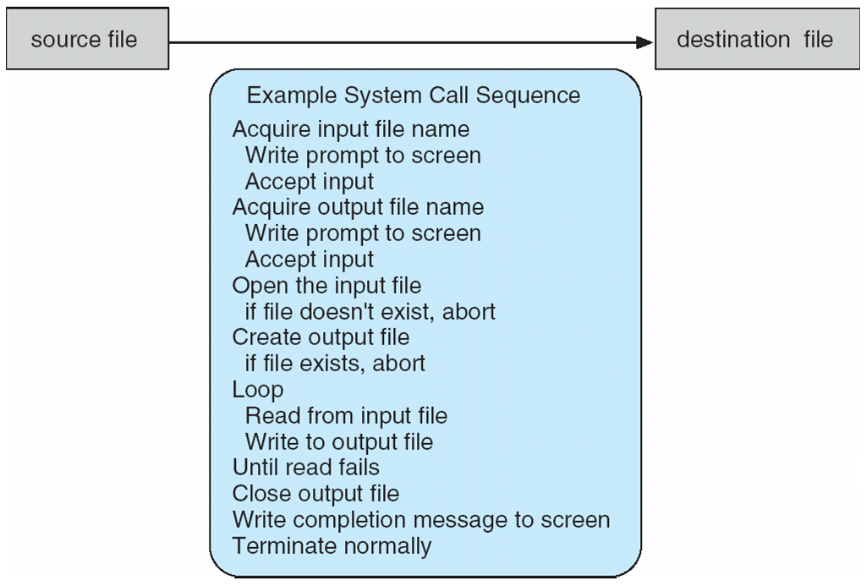
Example of System Calls
System call sequence to copy the contents of one file to another file

Slide 25
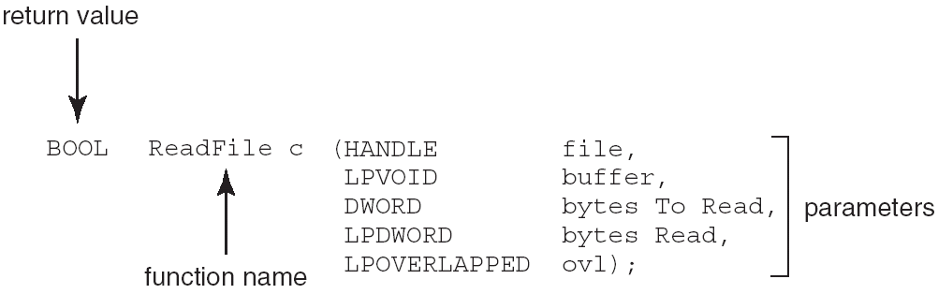
Example of Standard API
Consider the ReadFile() function in the
Win32 API—a function for reading from a file
A description of the parameters passed to ReadFile()
HANDLE file—the file to be read
LPVOID buffer—a buffer where the data will be read into and written from
DWORD bytesToRead—the number of bytes to be read into the buffer
LPDWORD bytesRead—the number of bytes read during the last read
LPOVERLAPPED ovl—indicates if overlapped I/O is being used

Slide 26
System Call Implementation
Typically, a number associated with each system call
System-call interface maintains a table indexed according to these numbers
The system call interface invokes intended system call in OS kernel and returns status of the system call and any return values.
The caller need know nothing about how the system call is implemented
Just needs to obey API and understand what OS will do as a result call
Most details of OS interface hidden from programmer by API
Managed by run-time support library (set of functions built into libraries included with compiler)

Slide 27
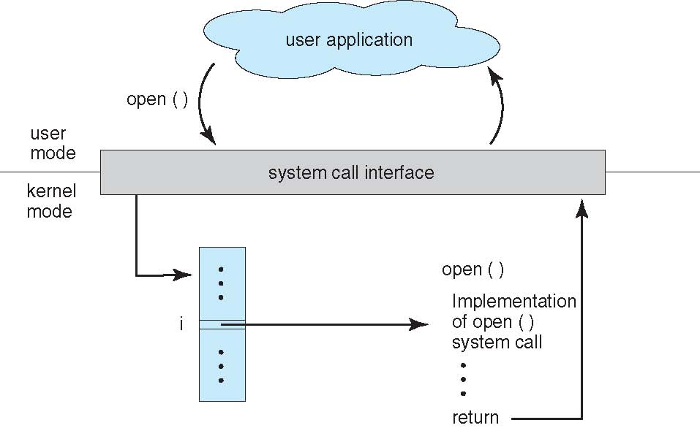
API – System Call – OS Relationship

Slide 28
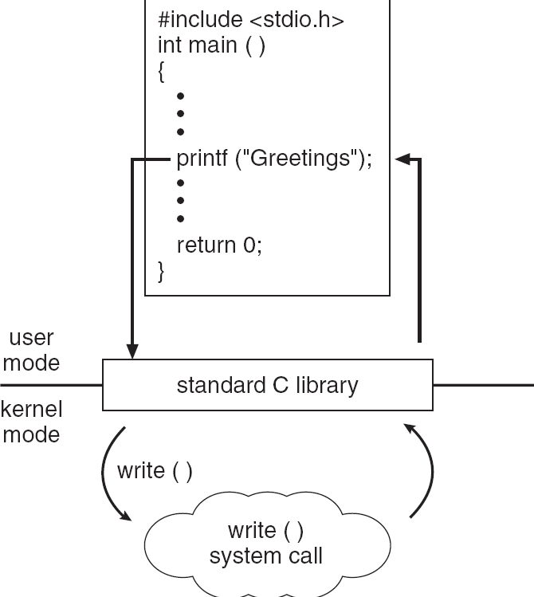
Standard C Library Example
C program invoking printf() library call, which calls write() system call

Slide 29
Types of System Calls
Process control
File management
Device management
Information maintenance
Communications
Protection

Slide 30
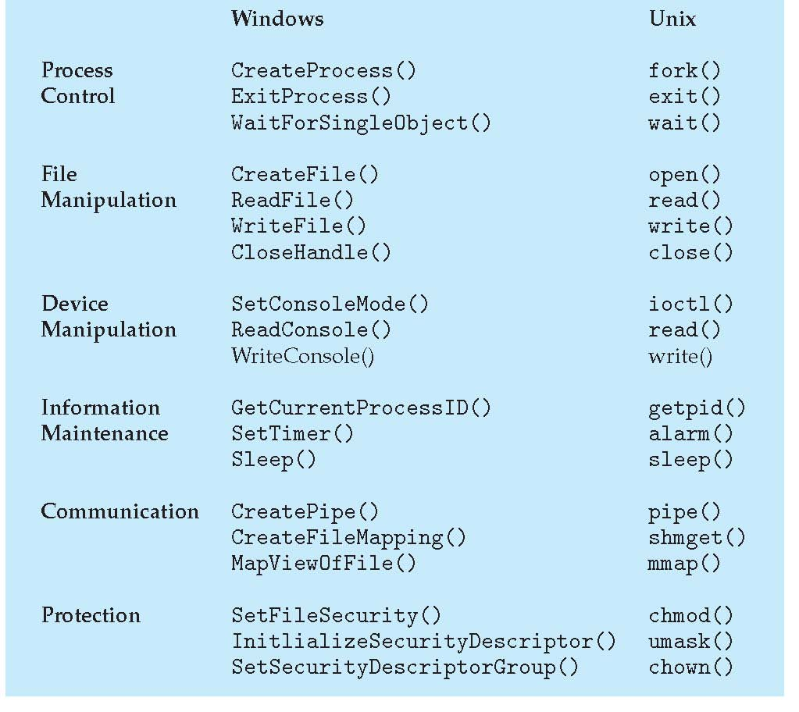
Examples of Windows and Unix System Calls

Slide 31
Operations on Processes
System must provide mechanisms for:
Process creation
Process termination

Slide 32
Process Creation
Parent process create children processes, which, in turn create other processes, forming a tree of processes
Generally, process identified and managed via a process identifier (pid)
Resource sharing options
Parent and children share all resources
Children share subset of parent’s resources
Parent and child share no resources
Execution options
Parent and children execute concurrently
Parent waits until children terminate

Slide 33
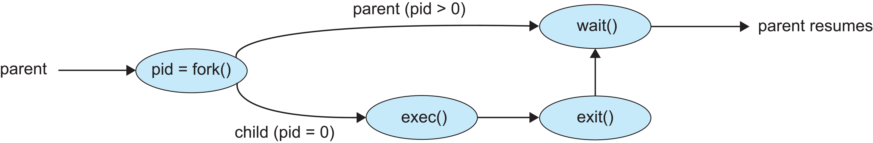
Process Creation (Cont.)
Address space
Child duplicate of parent
Child has a program loaded into it
UNIX examples
fork() system call creates new process
exec() system call used after a fork() to replace the process’ memory space with a new program
Parent process calls wait()waiting for the child to terminate

Slide 34
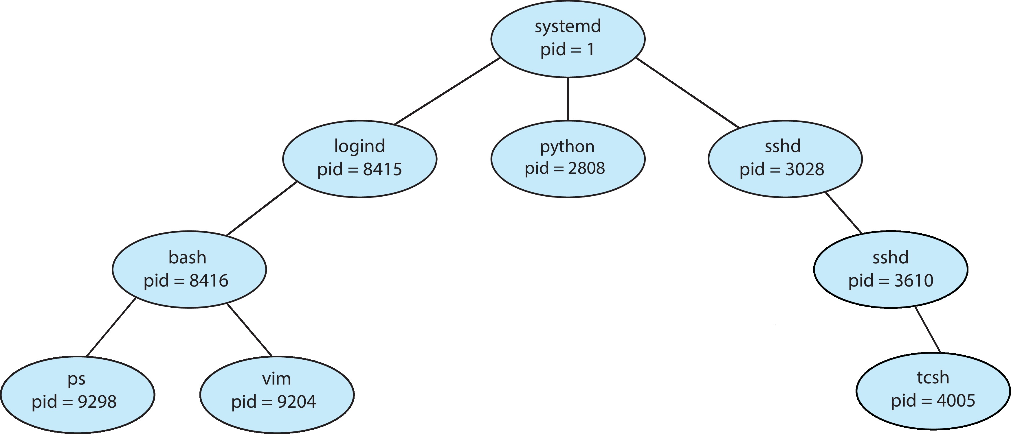
A Tree of Processes in Linux

Slide 35

C Program Forking Separate Process

Slide 36
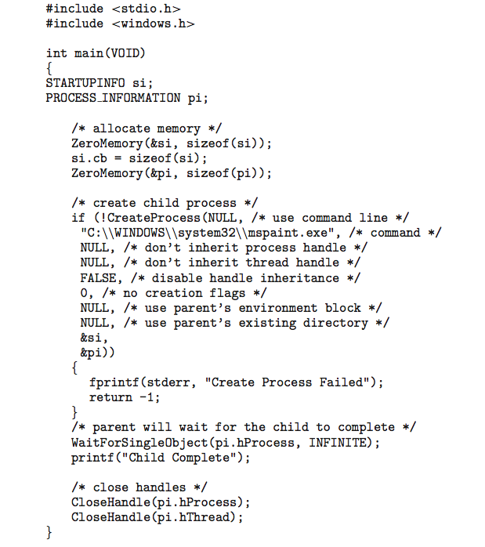
Creating a Separate Process via Windows API

Slide 37
Process Termination
Process executes last statement and then asks the operating system to delete it using the exit() system call.
Returns status data from child to parent (via wait())
Process’ resources are deallocated by operating system
Parent may terminate the execution of children processes using the abort() system call. Some reasons for doing so:
Child has exceeded allocated resources
Task assigned to child is no longer required
The parent is exiting, and the operating systems does not allow a child to continue if its parent terminates

Slide 38
Process Termination
Some operating systems do not allow child to exists if its parent has terminated. If a process terminates, then all its children must also be terminated.
cascading termination. All children, grandchildren, etc., are terminated.
The termination is initiated by the operating system.
The parent process may wait for termination of a child process by using the wait()system call. The call returns status information and the pid of the terminated process
pid = wait(&status);
If no parent waiting (did not invoke wait()) process is a zombie
If parent terminated without invoking wait(), process is an orphan

Slide 39
Android Process Importance Hierarchy
Mobile operating systems often have to terminate processes to reclaim system resources such as memory. From most to least important:
Foreground process
Visible process
Service process
Background process
Empty process
Android will begin terminating processes that are least important.

